Slide 1
Stock price analysis and prediction

Slide 2
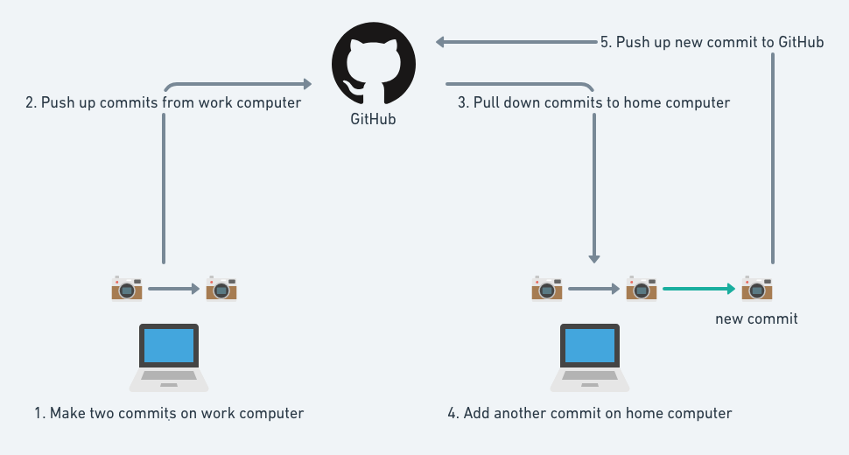
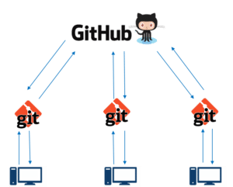
Cooperation on a project: GitHub

Slide 3
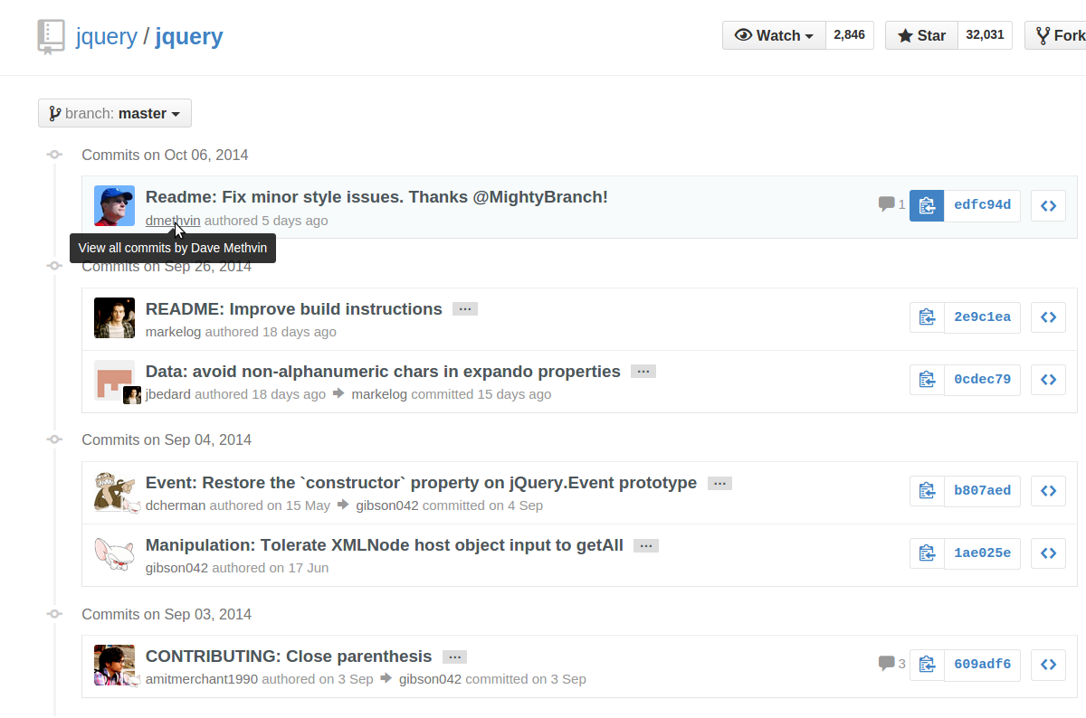
Cooperation on a project: GitHub

Slide 4
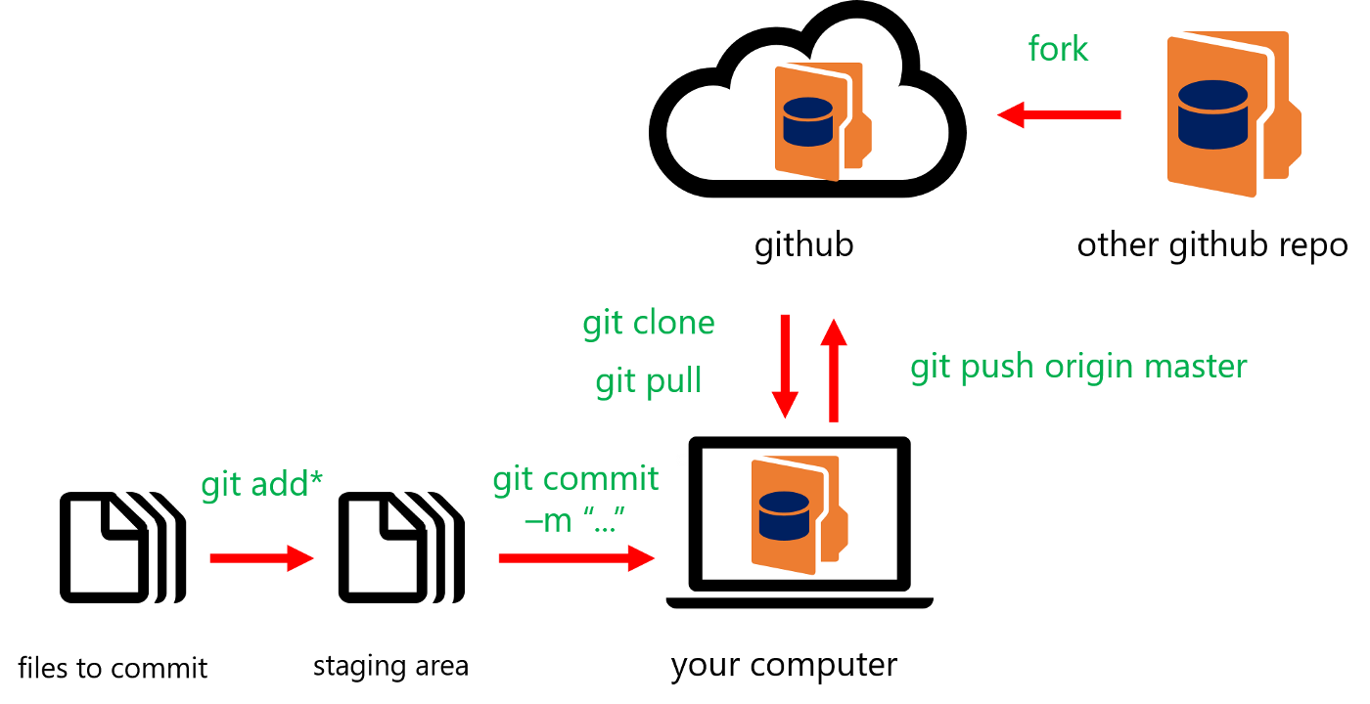
Cooperation on a project: GitHub

Slide 5
Interesting agregations and sumations…

Slide 6
Matipulation of data with pandas

Slide 7
Some basic plotting

Slide 8
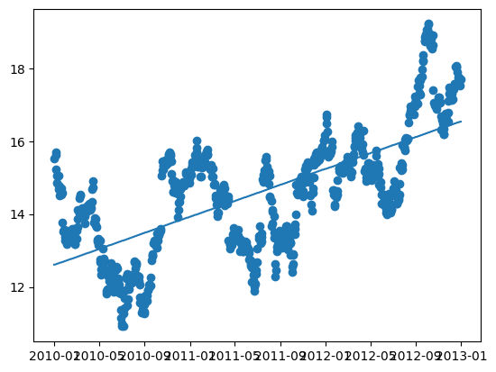
Linnear regression

Slide 9
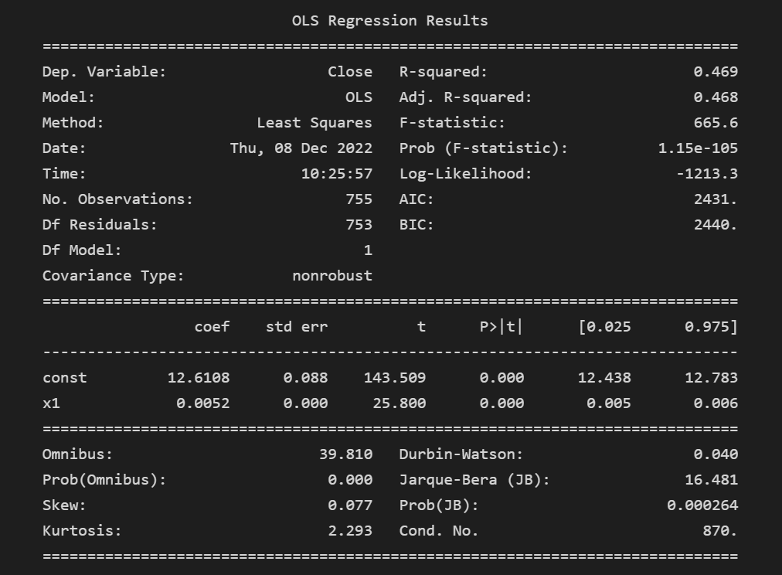
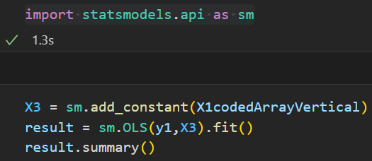
Linear regression

Slide 10
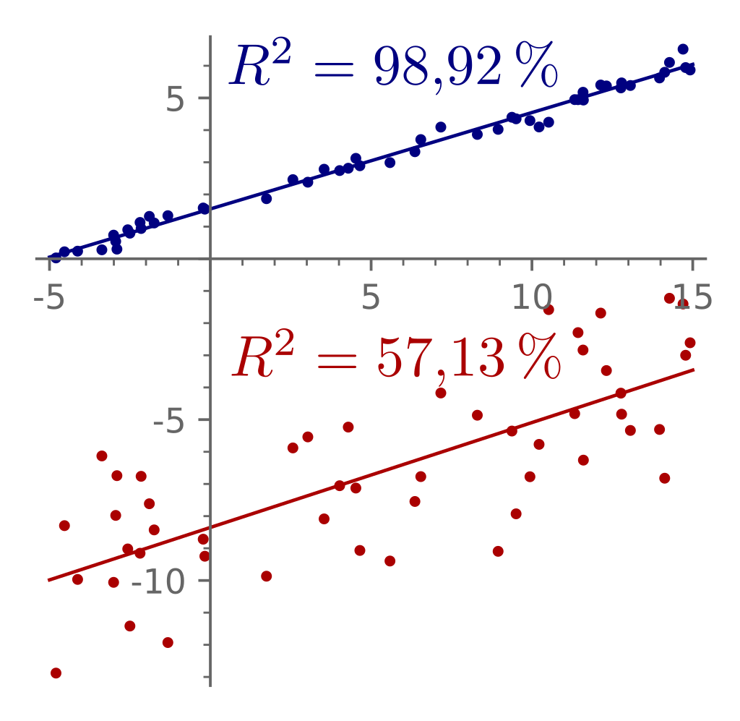

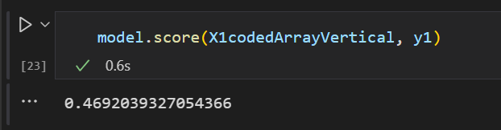
Problems with the model: R squared

Slide 11
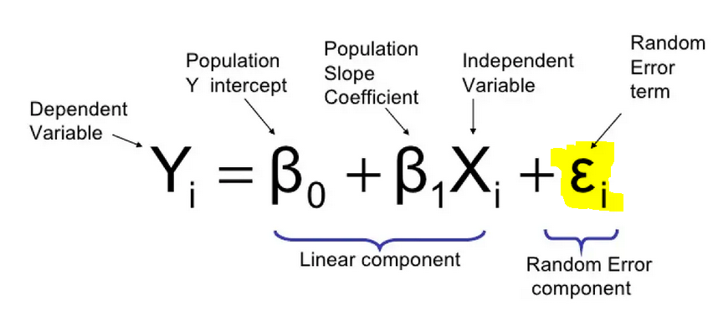
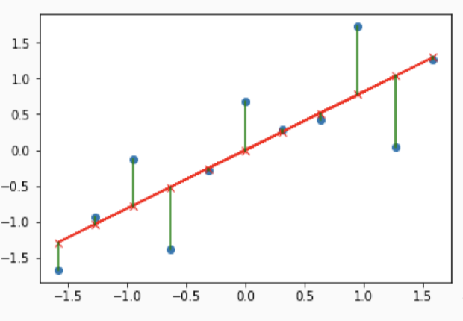
Residuals

Slide 12
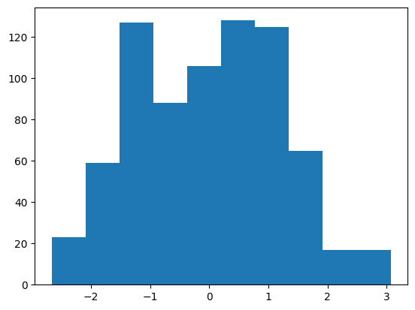
Problems with the model: residuals normally distributed?

Slide 13
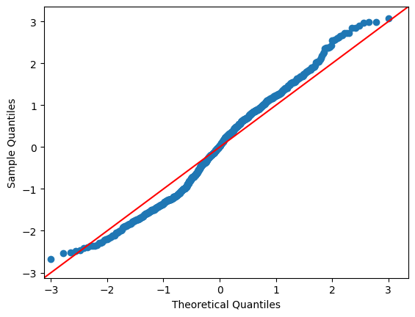
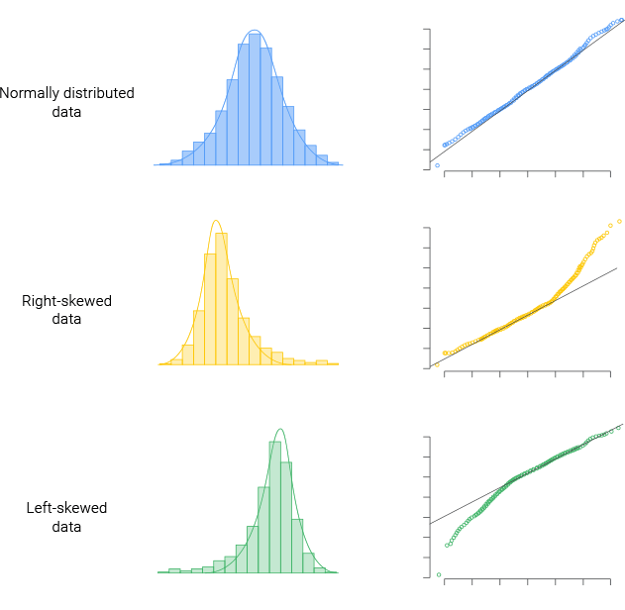
Problems with the model: Are residuals normally distributed?

Slide 14
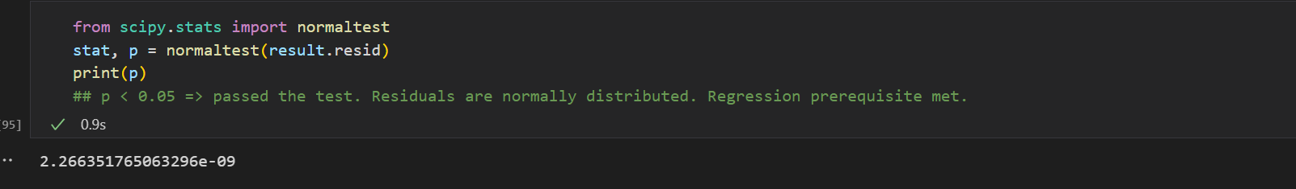
Problems with the model: residuals normally distributed?
p-value < 0.05 => passed the test. Residuals are normally distributed

Slide 15
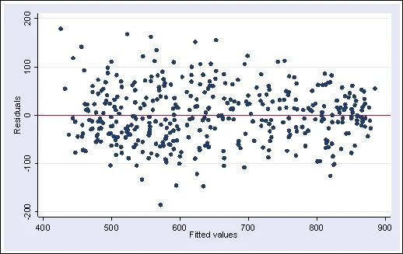
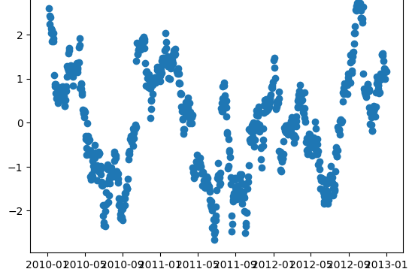
Problems with the model: Heteroskedasticity

Slide 16
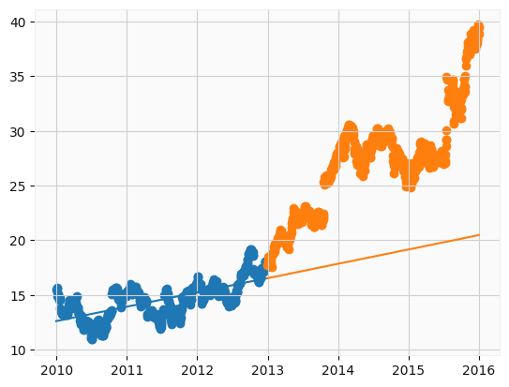
Problems with the model: Prediction

Slide 17
Other types of regression?

Slide 18
Better model: Prophet

Slide 19
Q/A

